Slide 1

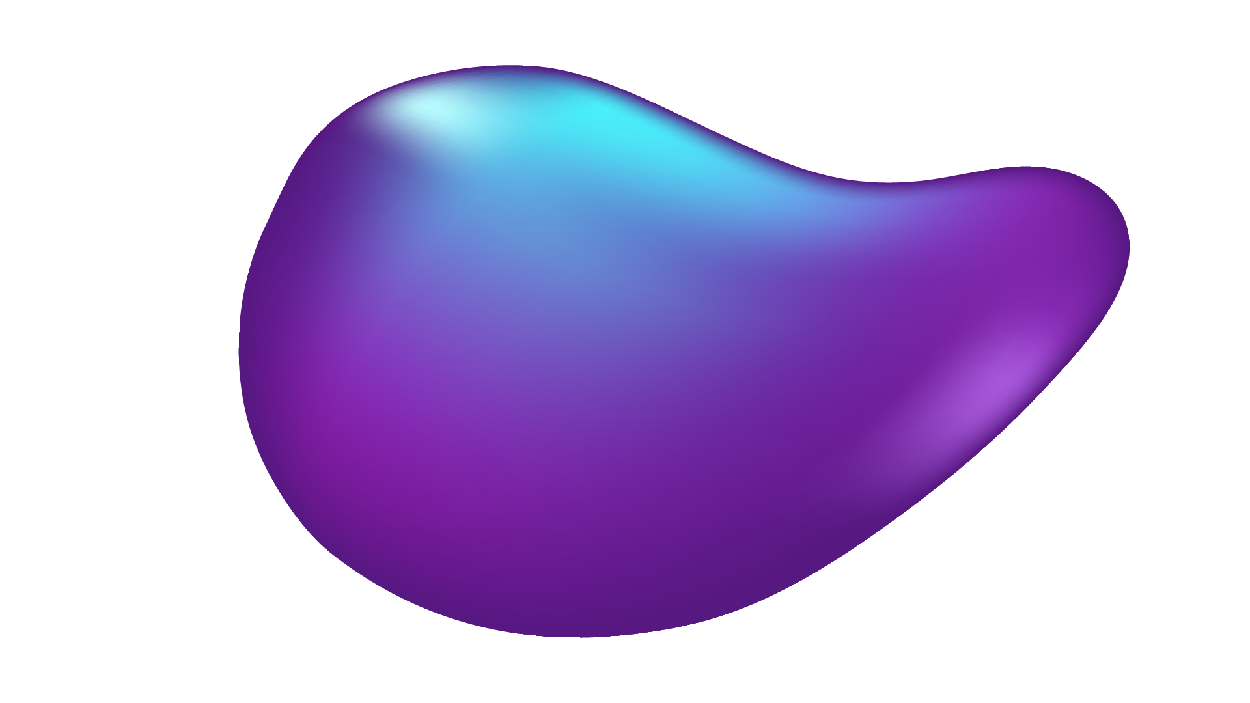
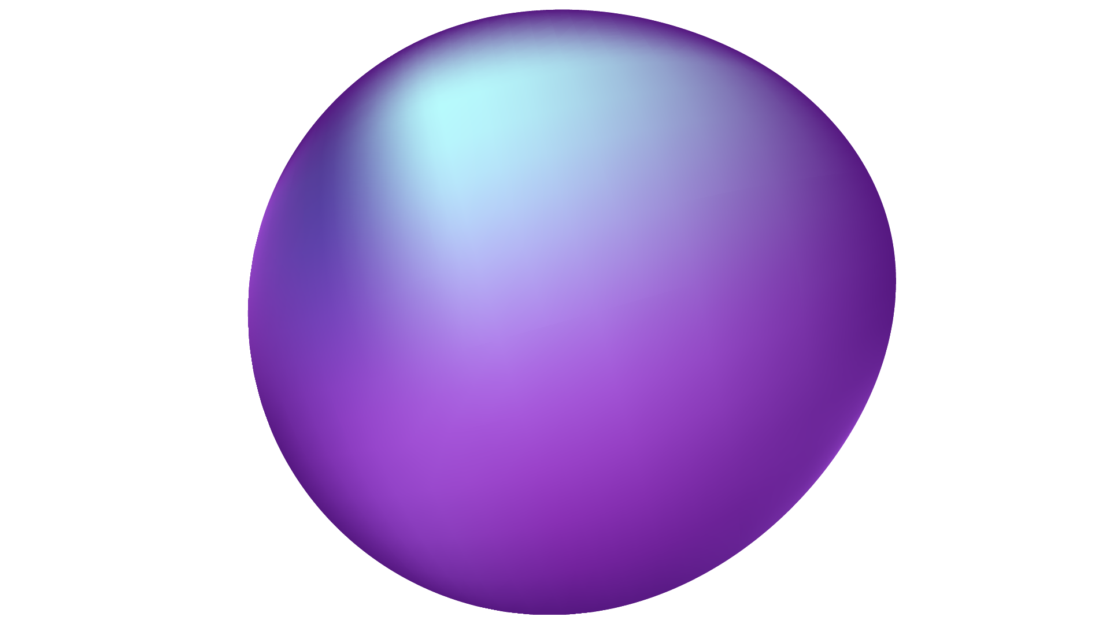
MNIST
DIGIT
CLASSIFICATION (AI)

Slide 2
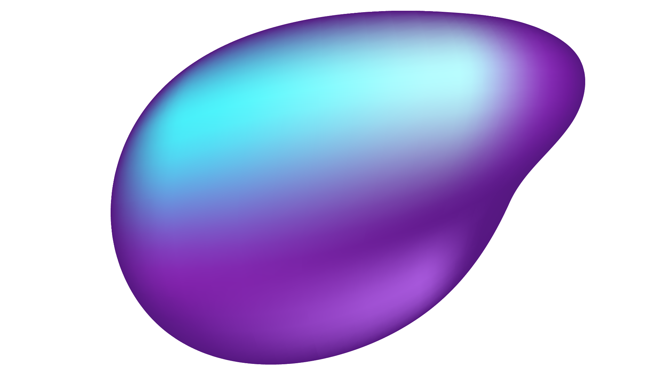
OUR GROUP MEMBERS
Ayesha Zia 20k0414
Robaisha Masood 20k0390
Syeda Ravia Ejaz
20k0246

Slide 3
PROJECT MOTIVATION: WHY MNIST DIGIT CLASSIFICATION?
MNIST digit classification: Dataset of handwritten digit images from 0 to 9 used in machine learning and computer vision
Main use: Training and evaluating image recognition algorithms, specifically for digit recognition
Applications: OCR, automated postal sorting, and digit recognition in bank checks and other documents
Widely used as a benchmark to evaluate the performance of various machine learning algorithms, including neural networks, support vector machines, and decision trees, among others
By accurately classifying handwritten digits, researchers and developers can create more advanced applications and improve existing ones.

Slide 4





IMPLEMENTATION

Slide 5

HOW DOES IT WORK?
The classifier is trained using a neural network to detect input images of handwritten digits
The input images consist of digits from 0 to 9, and the neural network must detect which digit is represented in the image
The neural network is a single-digit detection neural network, meaning it can only detect one digit at a time
Once the neural network is trained to detect the digit correctly, it is then tested with some test data to verify its accuracy
During the testing phase, the neural network is given new input images that it has not seen before to evaluate its ability to accurately detect the digit
The training and testing process helps in building a single-digit detection classifier that can be used for various applications
By accurately detecting the digit in the input image, the classifier can improve the accuracy and efficiency of these applications.

Slide 6
DEPENDENCIES
Numpy | The NumPy library will produce the array from the images
Matplotlib | Matplotlib, numpy arrays will be visualized using this library. Once we plot the array on matplotlib we can see which image we have.
Seaborn | Seaborn is also used for visualization
Tensorflow and Keras
Random seeds
cv2 | cv2 is an open computer vision library. One of the important libraries used for image recognition tasks
Confusion Matrix from Tensorflow
PIL Python Imaging Library

Slide 7
METHOD FOLLOWED
01
02
03
04
05
06
07
08
09
Data Collection
Image Processing
Importing Dependencies
Importing Deep Learning Libraries
Resizing the images
Scaling the Data
Normalization
Setting up the Layers of Neural Network
Activation Function

Slide 8
METHOD FOLLOWED
10
11
12
13
14
15
16
17
18
Compiling the Neural Network
Optimizer
Accuracy
Training the Neural Network
Model Evaluation
Final Prediction
Building the confusion Matrix
Building the Predictive system
Reshape the image

Slide 9
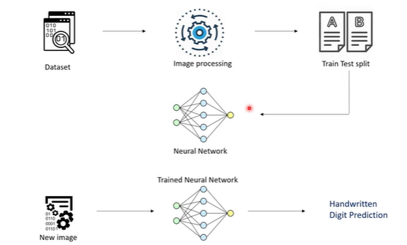
WORKFLOW

Slide 10
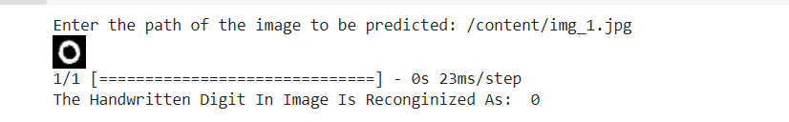
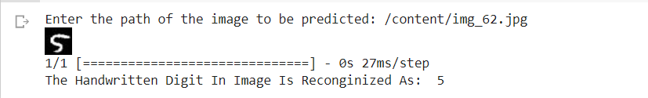
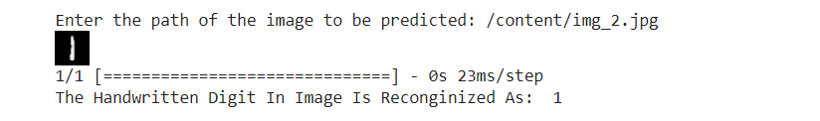
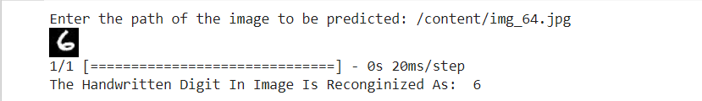
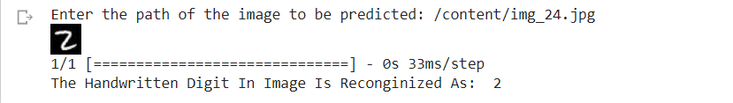
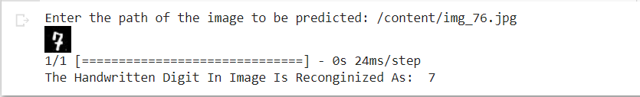
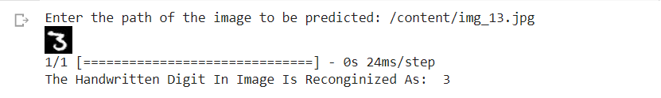
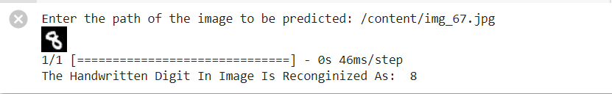
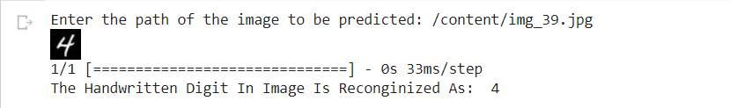
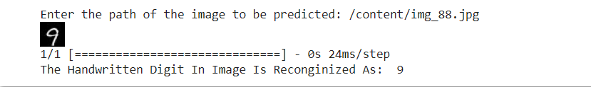
RESULTS

Slide 11
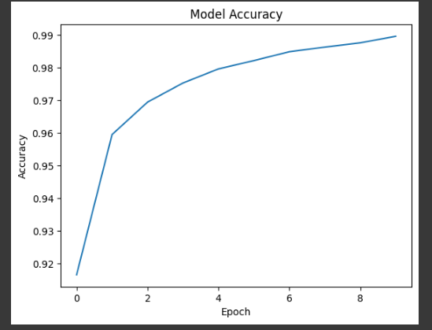
PERFORMANCE MEASUREMENT
After training the model on the MNIST dataset, we achieved an accuracy of around 97.1%, which is an excellent result for this task. We also tested the model on a separate set of images and found that it performs well in classifying new images accurately.

Slide 12
PERFORMANCE CHECKS
High Accuracy
Our designed model is able to achieve high accuracy of 97.1 using the Convolutional Neural Network.
Various Applications
This model can be used in Optical Character Recognition (OCR), Fraud detection, robotics, medical diagnosis, banking and finance and in many other applications.
improvement by fine-tuning the model's hyperparameters or by implementing more advanced neural network architectures
Room for Improvements

